Slide 1
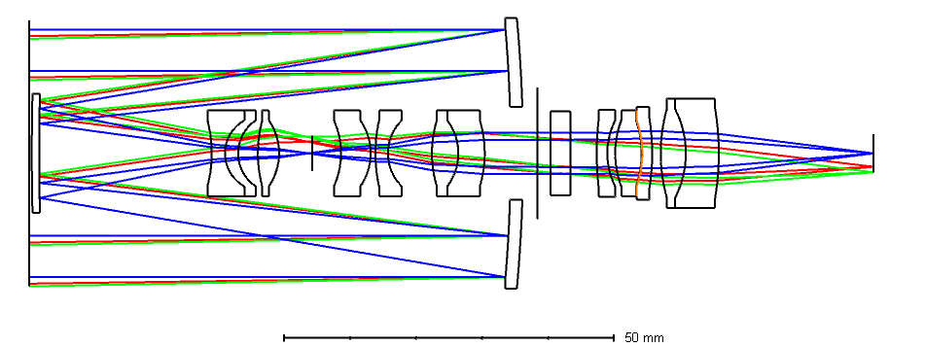

Slide 2
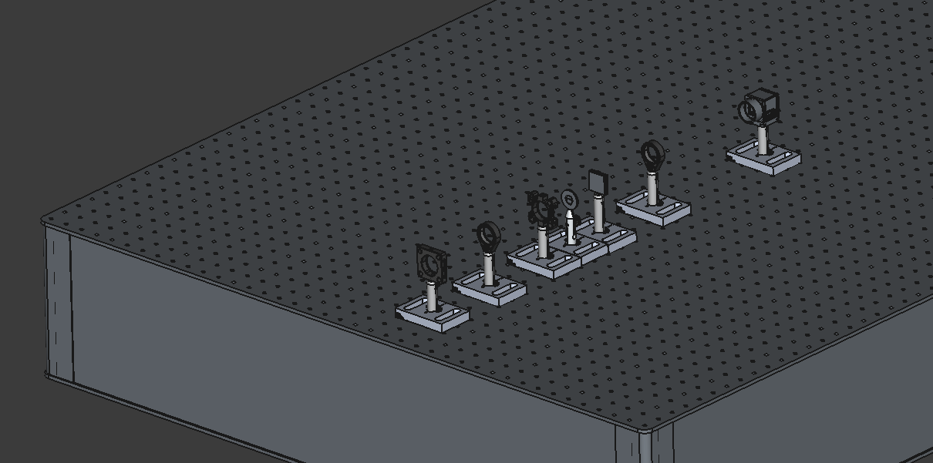
Focusing Lens
Image Sensor
Slit
Grating
Primary Mirror
Collimating lens
Secondary Mirror

Slide 3
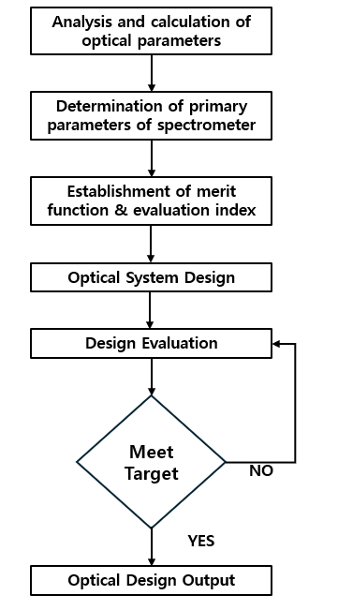
Imager requirement Definition
Determination of primary fore optics + spectrometer specifications
Establishment of merit function & evaluation index
Optical system design
Optical Design iteration path
Design evaluation & Optimization
Meet Target
NO
YES
Tolerancing
Fabrication iteration path
Optomechanical Design
Fabrication

Slide 4
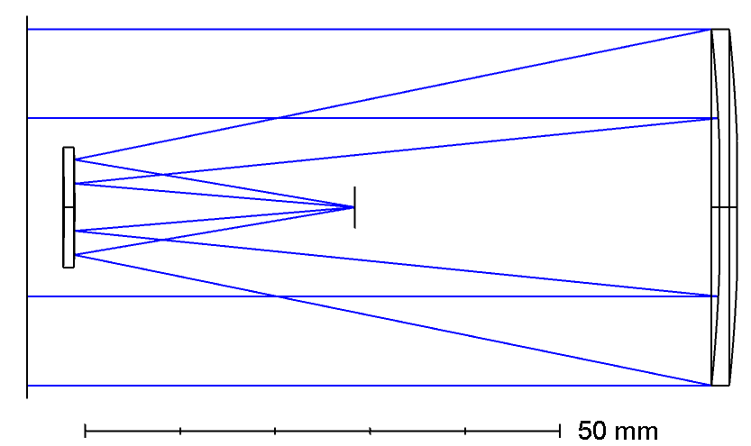
Primary Mirror
Secondary Mirror
Image Plane

Slide 5
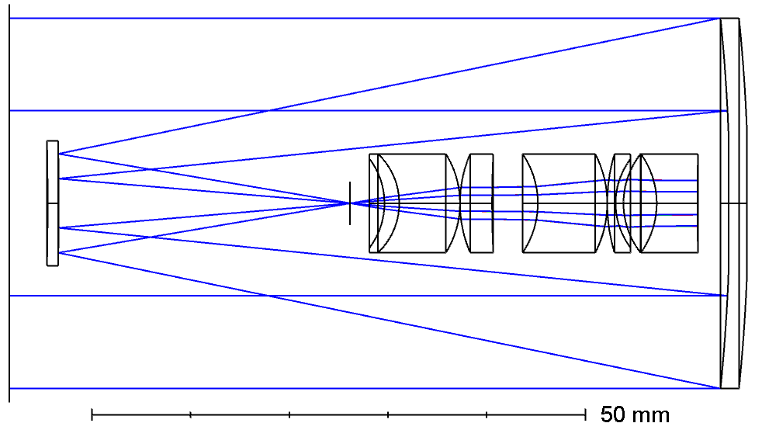
Primary Mirror
Relay lens I
Secondary Mirror
Slit

Slide 6
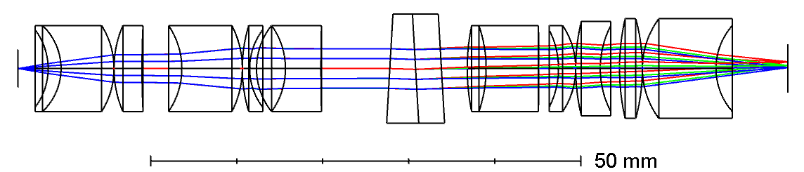
Relay lens II
Relay lens II
Prism-grating
Slit
CMOS Sensor

Slide 7
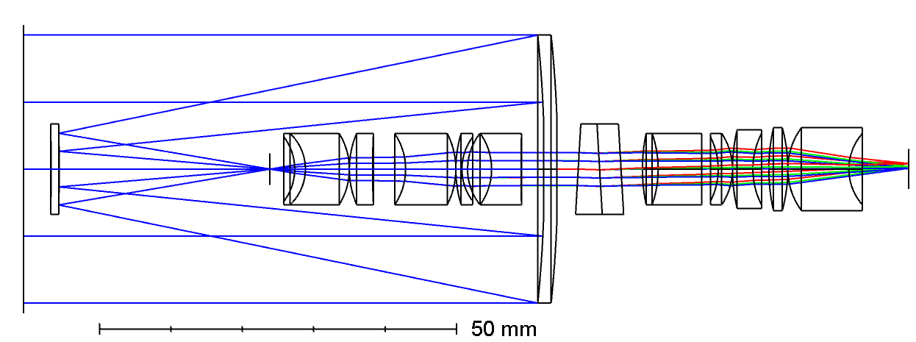
Primary Mirror
Secondary Mirror
Prism-grating
Slit
CMOS Sensor
Relay lens I
Relay lens II

Slide 8
Fore Optics
Spectrometer
Plane of Connection

Slide 9
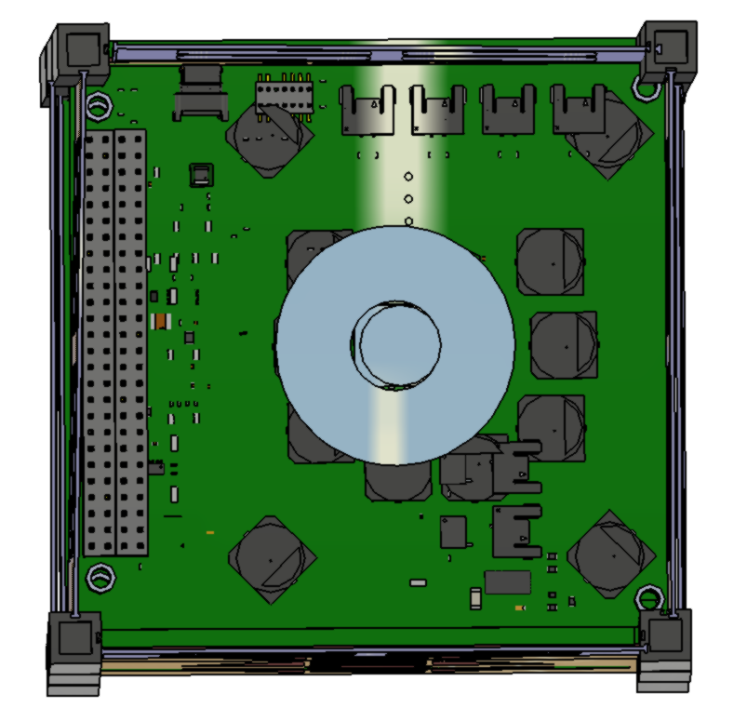
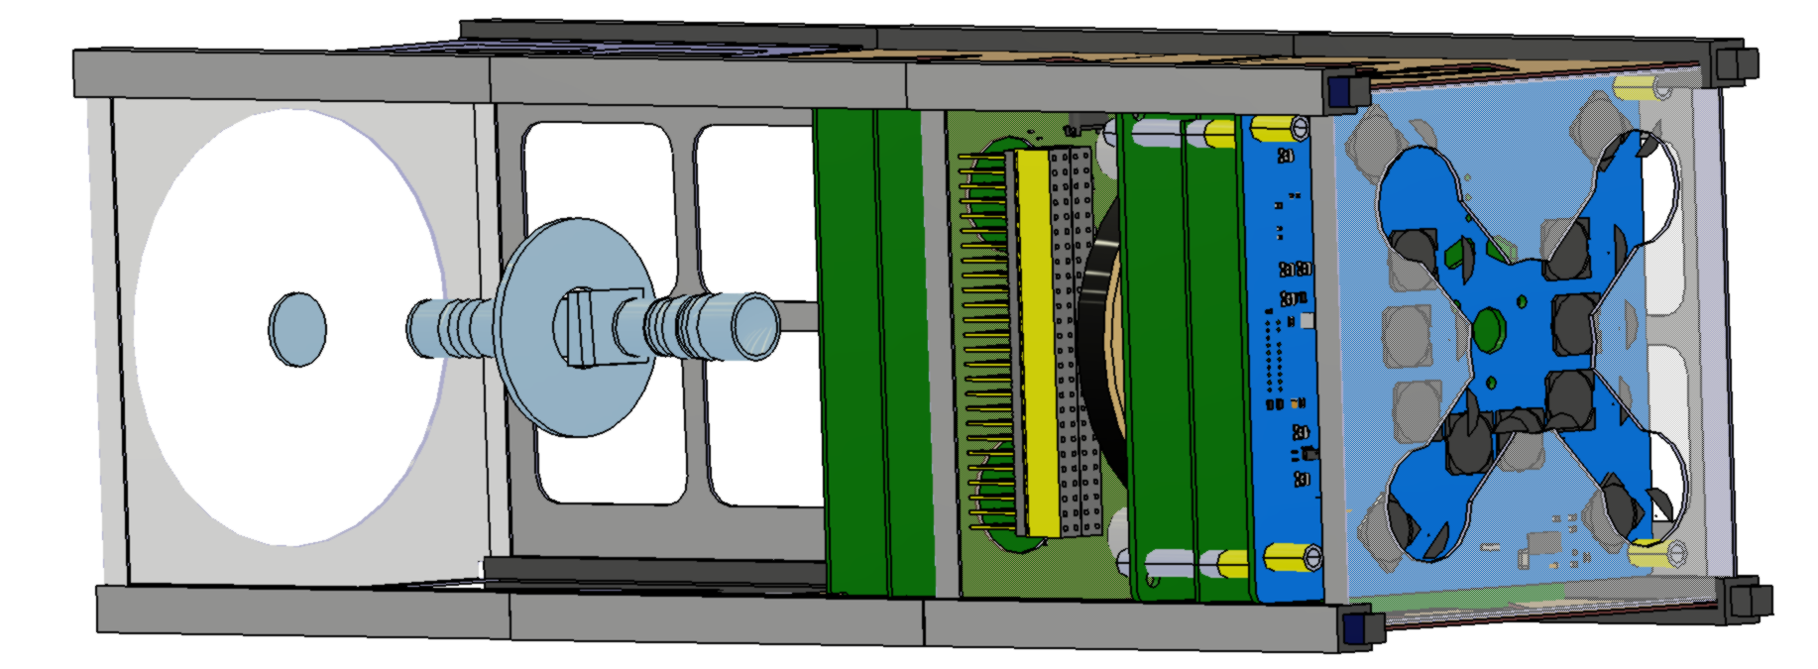
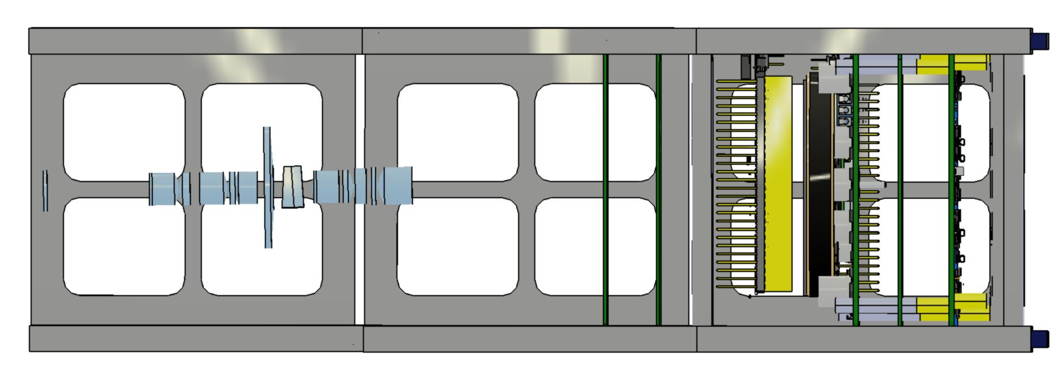
100 mm
100 mm
100 mm
118 mm
300 mm

Slide 10
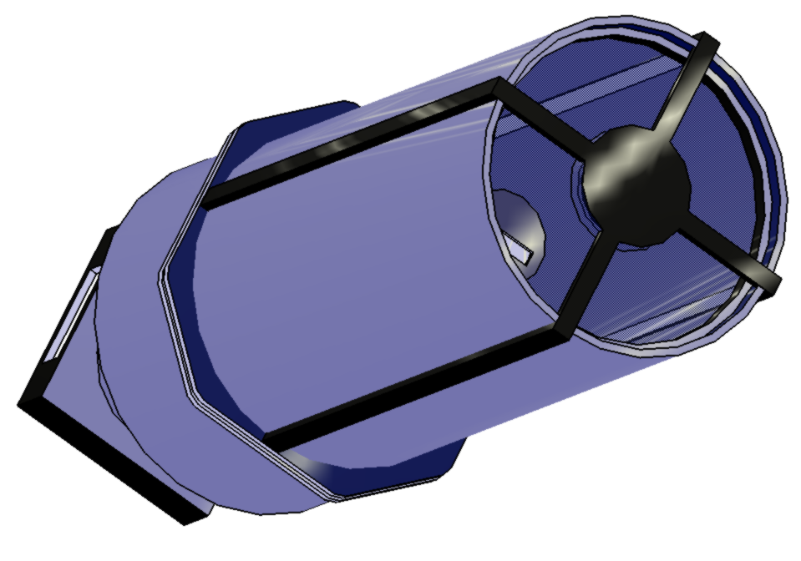
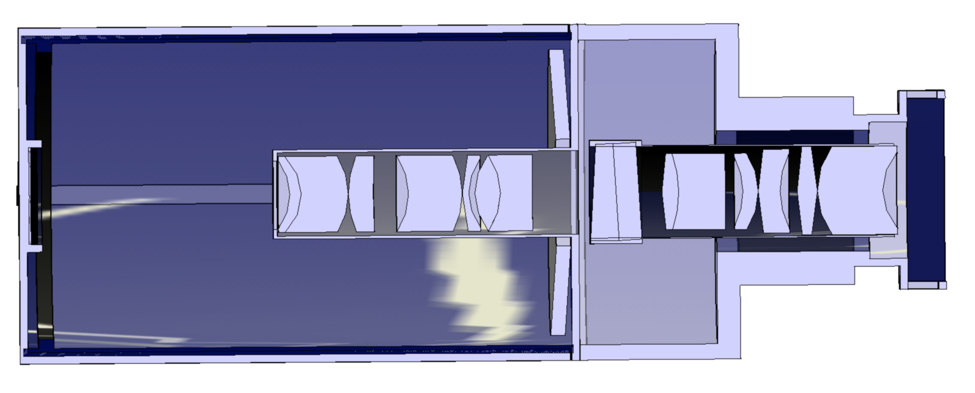
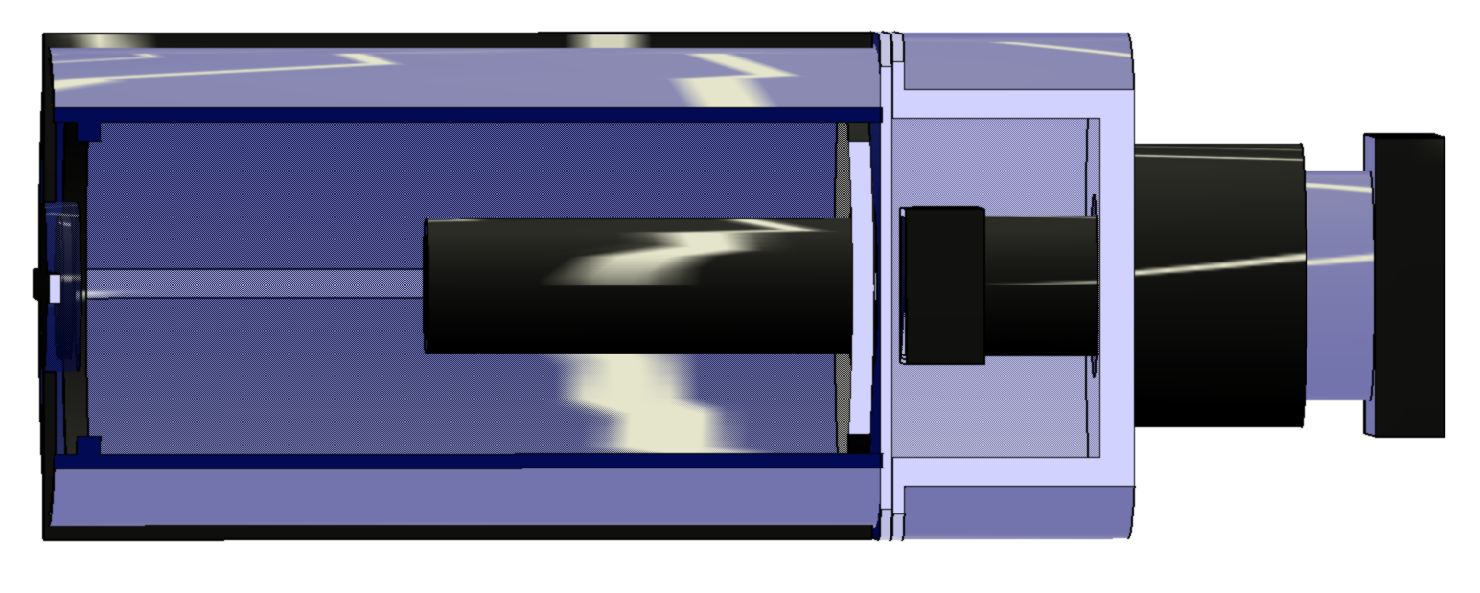
Cross-section view
Secondary Mirror housing
Relay lens I housing
Primary Mirror housing
Relay lens II housing
Sensor housing
Prism-grating

Slide 11
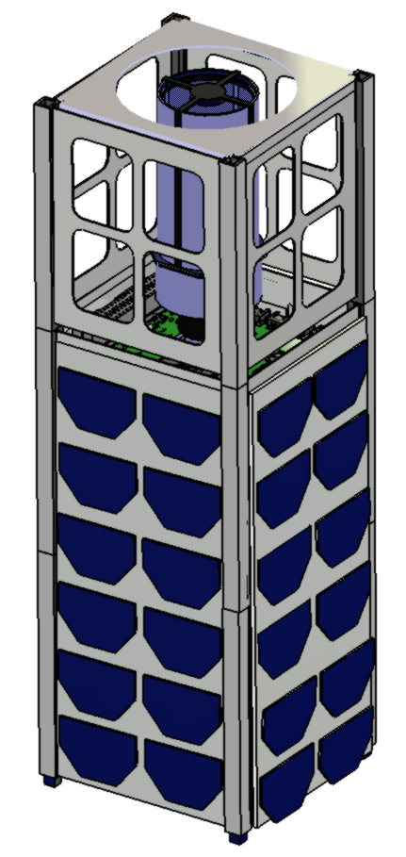
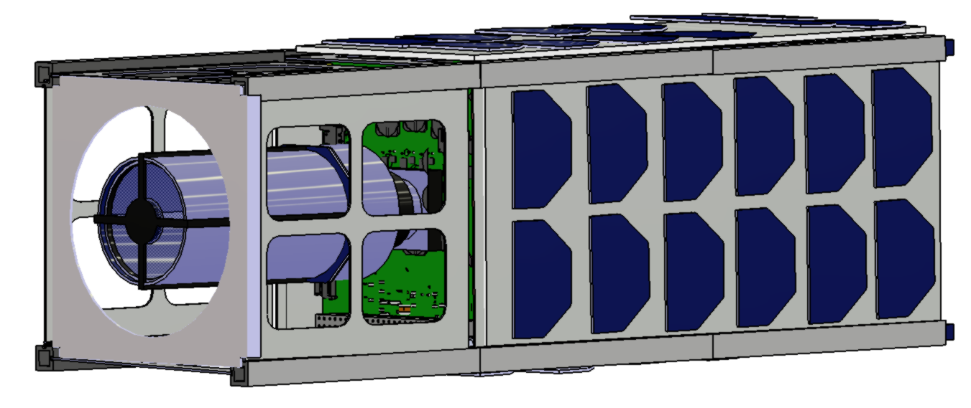
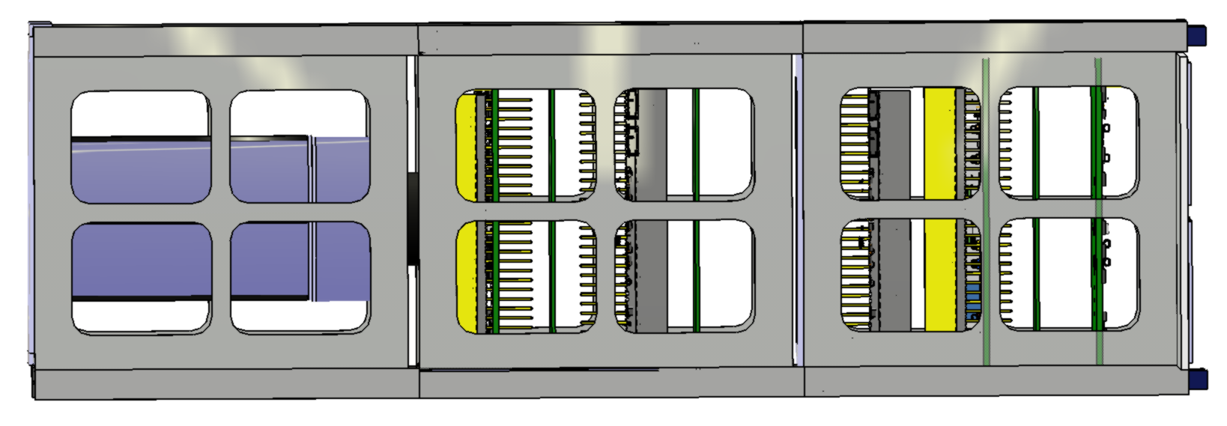
100 mm
120 mm
300 mm

Slide 12



Fore-Optics $$L_{0}$$
Slit
S
Relay Lens I $$L_{1}$$
Prism-Grating
Relay Lens II
$$L_{2}$$
CMOS Sensor
C

Slide 13
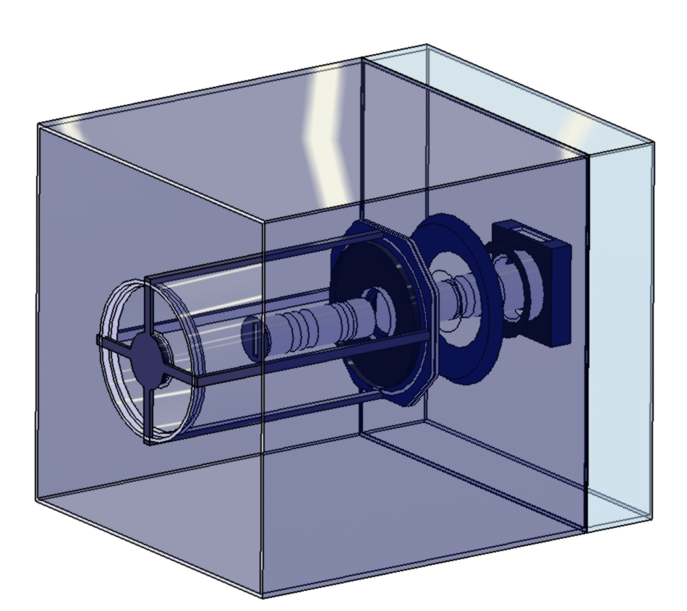
100 mm
100 mm
20 mm
100 mm

